Slide 1
Dynamic SQL Scripts
Using substitution variables

Slide 2
Objective of using substitution variables:
Produce queries that require input from the user
You make up the variable name
Starts with “&”
No spaces
Notes:
Oracle8 is the first object-relational database model developed by Oracle.
This means object-oriented programming, complex datatypes (image, sound, video, and time series) are available & they’re fully compatible with the relational world.
Oracle 8 supports client-server and Web-based applications

Slide 3
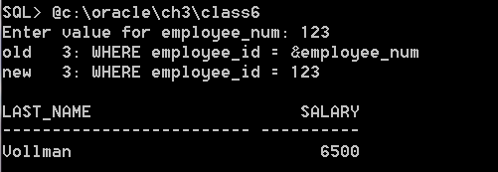
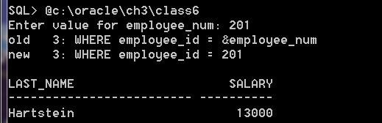
& Substitution variable
SELECT last_name, salary
FROM employees
WHERE employee_id = &employee_num;
Line 3 is
changed
Run it
again

Slide 4
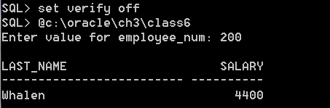
Set verify on/off
Set verify off
Old/new lines
are not shown
Note: the verify remains off
until you set it on again by
Entering “Set verify on”
(or you exit the session.)

Slide 5
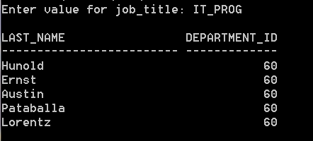
Entering char and date values: put substitution variable in quotes
SELECT last_name, department_id
FROM employees
WHERE job_id = ‘&job_title’;
The user
doesn’t
have to
enter
quotes

Slide 6
The && substitution variable
Use the double ampersand if you want to reuse the variable value without prompting the user each time
Value is good as long as you are logged in
Or until you use an UNDEFINE command

Slide 7
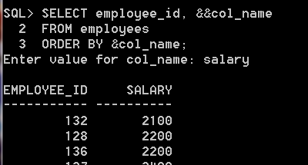
&& Substitution variable
SELECT employee_id, &&col_name
FROM employees
ORDER BY &col_name;
NOT prompted twice

Slide 8
However….
The value of the && substitution variable “sticks” for subsequent runs of the query

Slide 9
UNDEFINE
UNDEFINE col_name
That will “clear out” the value from the previous run

Slide 10
Customizing the SQL*Plus environment:
SET system_variable value
SHOW – display the current setting
SQL> SET VERIFY ON SQL> SHOW VERIFY
Verify ON
SHOW ALL to see all set variable values

Slide 11
You can set:
FEEDBACK {ON|OFF}
Tells you how many records selected
VERIFY {ON|OFF}
Displays before and after a substitution variable
HEADING {ON|OFF}
Determines whether column headings are displayed or not
Default values underlined

Slide 12
Set commands continued
LINESIZE {80|n}
Set the width of the line for reports
PAGESIZE {24|n}
Set the number of lines per page of output
PAUSE {OFF|ON}
Allows you to control scrolling of output. Must press [return] after each pause.

